Slide 1
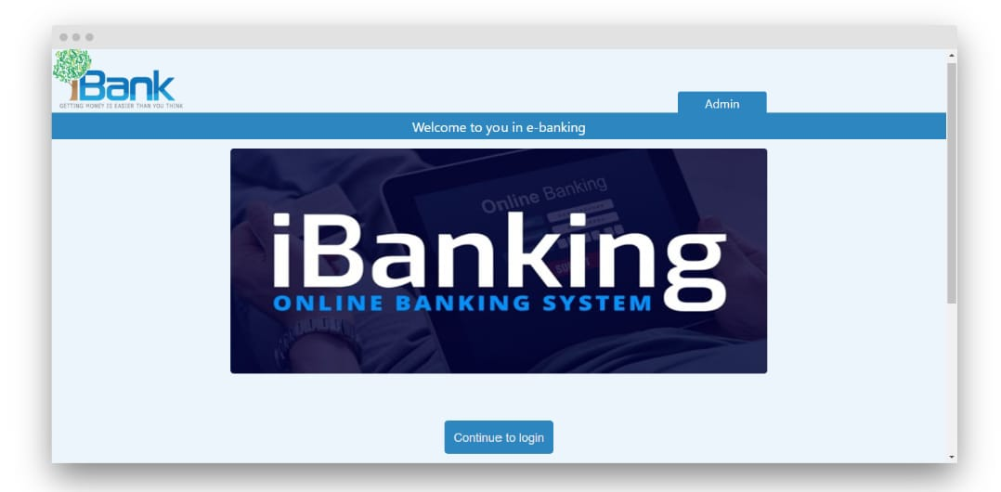
Application website for e banking

Slide 2

AIM :- TO ANALYSE e-commerce application for E-Banking

Slide 3
Requirements
LOGIN MODULE
2.USER NAME (E –MAIL)
3.PASSWORD
4.WEBSITE(www.amazon.in)

Slide 4
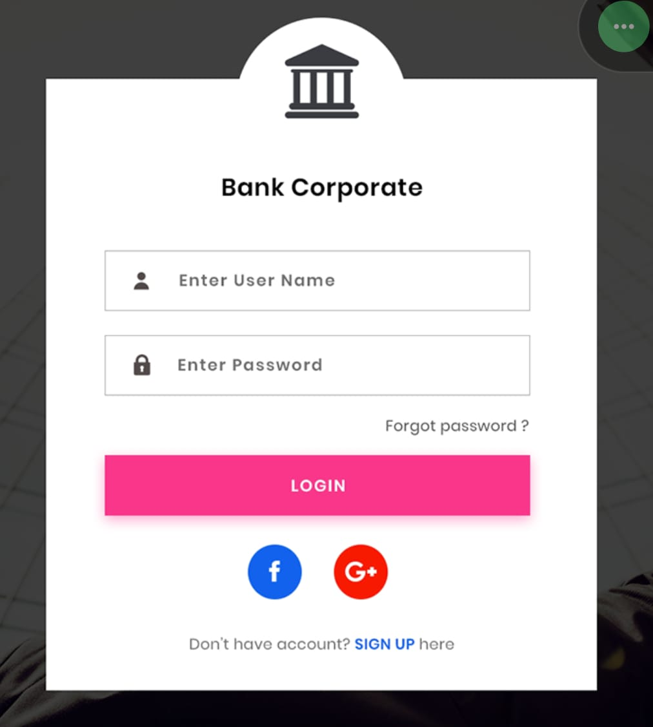
Amazon login page

Slide 5

Searching page

Slide 6
POSITIVE TEST SCENARIO
Verify Admin login with valid and Invalid data
Verify admin login without data
Verify all admin home links
Verify admin change password with valid and invalid data
Verify admin change password without data
Verify admin change password with existing data
Verify admin logout

Slide 7
Negative test scenario
1.Enter incorrect user name and password(Authorization should be failed)
2.Check A/C balance for sufficient to transfer(if A/C balance<1000) transfer is not allowed.
3.Enter the wrong authorization code for transfer.
4.Enter the A/C number, Branch name to transfer. (wrong details, transfer not enabled).
5.Transfer amount > max limit, transferring the amount denied.

Slide 8
TEST CASES
Test cases | Type – negative/positive
Verify Admin login with valid and Invalid data | Positive
Enter incorrect user name and password(Authorization should be failed). | Negative
Check A/C balance for sufficient to transfer(if A/C balance<1000) transfer is not allowed | Negative
Verify admin login without data | Positive
Verify all admin home links | Positive
Enter the wrong authorization code for transfer | Negative
Verify admin change password with valid and invalid data | Positive
Verify admin change password without data | Positive
Enter the A/C number, Branch name to transfer. (wrong details, transfer not enabled). | Negative
Transfer amount > max limit, transferring the amount denied. | Negative

Slide 9
conclusion
I have navigate the E-banking web application and find out the positive / pass and negative / fail test cases. This is to improve the application performance in better manner.

Slide 10


